Slide 1
GUJARAT TECHNOLOGICAL UNIVERSITY
BIRLA VISHVAKARMA MAHAVIDYALAYA
(ENGINEERING COLLEGE)
VALLABH VIDYANAGAR
SUBJECT: ELEMENTS OF CIVIL ENGINEERING (CODE-2110004)
BE First Level First Semester (Self Finance)
PRACTICAL: CONVENTIONAL SYMBOLS, CHAIN SURVEY AND OFFSET MEASUREMENTS
PREPARED BY:
GUIDED BY:PROF.C.B.MISHRA (CIVIL ENGG. DEPT.)
STUDENTS NAME | ID.NO. | ENROLLMENT NO.
MOD. JISHAN KHAN | 13PES-16 | 130080125024
NEEL SUTHAR | 13PES-17 | 130080125032
MILAN LAKHANI | 13PES-28 | 130080125009

Slide 2
PRACTICAL 1 : CHAIN SURVEYING
AIM: To get the location of objects with respect to survey line.
APPRATUS: 20m/30m metric chain, Ranging rods, wooden pegs, hammer, steel arrow & Optical/Prism square.
PROCEDURE: 1. Select the two survey stations which are intervisible on a fairly level ground
2. Unfolding the chain according to the procedure
3. If length of survey line is more than chain length then perform ranging operation
4. Fix station points and intermediate points if required, stretch the chain between two station points, leader pulls the chain and fixes arrows at the end of each and every chain length. Follower collects arrows while moving forward
5. Initially, prepare reference sketch with respect to assumed North for both survey stations.
6. Take perpendicular/oblique offsets to various object with respect to chain and record it in field book (see typical field page as shown in answer to Qs. 3)
7. Measure the length of survey line and lastly fold the chain.
CONCLUSION: We have learn to draw field book page with its location by using chain surveying method during practical hours

Slide 3
Taking offsets

Slide 4
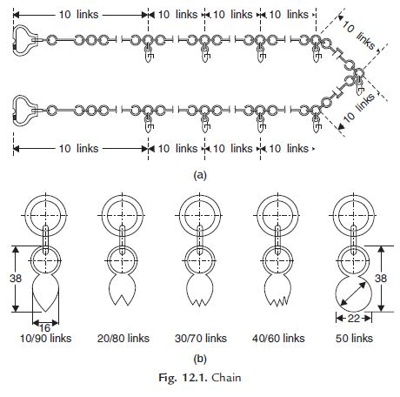
Q-1 How many links are there in 20m chain? At what interval tallies are provided? What is the length of each link?
Ans.:There are 100 links in 20m chain. Each tally has different shape which indicate either 5m, 10m, 15m from any one of the ends of the chain. The length of each link is 20.0cm

Slide 5
Q-2. Name different types of surveys
Ans.: Surveys can be classified into various categories depending on the purposes, instruments and methods used and the nature of the field.
Classification based on Instruments:
Chain surveys:
This is the simplest type of surveying in which only linear measurements are made with a chain or a tape. Angular measurements are not taken.
Compass survey:
In compass survey, the angles are measured with the help of a magnetic compass.
Chain and Compass Survey:
In this survey linear measurements are made with a chain or a tape and angular measurements with a compass.
Plane Table Survey:
It is a graphical method of surveying in which field works and plotting both are done simultaneously.

Slide 6
Theodolite survey:
In this survey, the horizontal angles are measured with a theodolite more precisely than compass and the linear measurements are made with chain or a tape.
Tachometry survey:
A special type of theodolite known as tachometer is used to determine horizontal and vertical distances indirectly.
Levelling survey:
This type of survey is used to determine the vertical distances and relative heights of points with the help of an instrument known as level.
Photogrammetric survey:
Photogrammetry is the science of taking measurements with the help of photograph taken by aerial camera from the air craft.
EDM survey:
In this type of survey, all measurements (length, angles co-ordinates) are made with the help of EDM instruments (i.e. total station).
Classification based on Method:
Triangulation:
Triangulation is a basic method of surveying. When the area to be surveyed is large, Triangulation is adopted. The entire area is divided into a network of triangles.

Slide 7
Traversing:
A traversing is a circuit of survey lines. It may be open or closed. When The linear measurements are done with a chain and a tape and the directions or horizontal angles are measured with a compass or a theodolite respectively, the survey is called traversing.
Classification based on Purposes:
Geological Survey:
In this both surface and subsurface surveying are conducted to locate different minerals and rocks. In addition, geological feature of the terrain such as folds and are locate.
Mine Survey:
Mine surveys include both surface and underground surveys, It is conducted for the exploration of mineral deposits and to guide tunneling and other operations associated with mining.
Archaeological Survey:
It is conducted to locate relics of antiquity, civilization, Kingdome, forts, temples, etc.

Slide 8
Military survey:
It has a very important and critical application in the military. Aerial surveys are conducted for this purpose. It is conducted to locate strategic positions for the purpose of army operations
Classification based on Nature of Field:
Land Survey:
Land Survey is done on land to prepare plans and maps of a given area. Topographical, city and cadastral surveys are some of the examples of land surveying.
Hydrographic Survey:
This survey is conducted on or near the body of water such as lake, river, and coastal area. This survey consists of locating shore lines of waters bodies.
Astronomic Survey:
The surveys are conducted or the determination of latitudes, longitudes, azimuths, local time, etc. for various places on the earth by observing heavenly bodies (The sun or star).
Aerial Survey:
An aerial survey is conducted from aircraft. Aerial cameras take photographs of the surface of the earth in overlapping strips of land. This is also known as photographic survey.

Slide 9
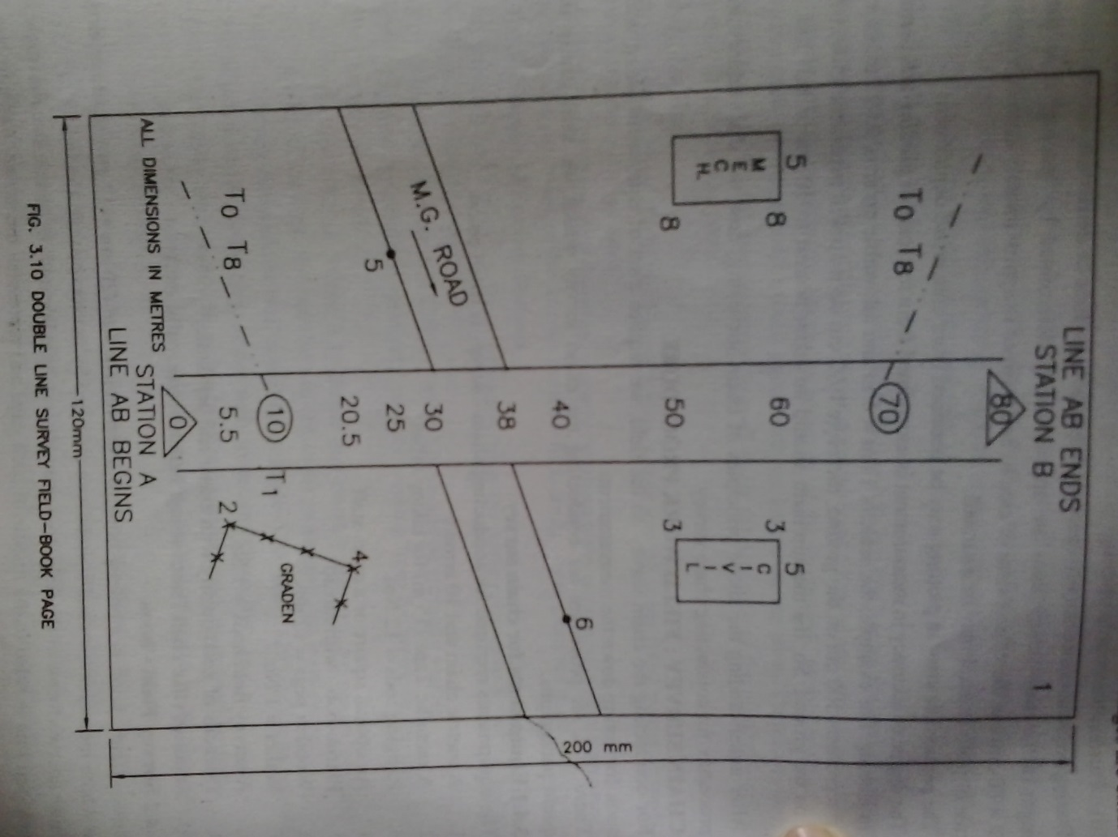
Q-3 Draw typical page of field book showing chain crossing, Road, Hedge, Tree, Tie station, Building, Electric pole?

Slide 10
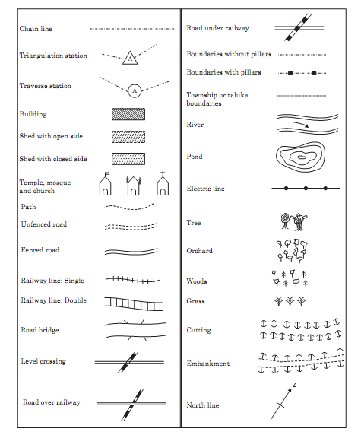
Q-4 Draw convention and symbols.

Slide 11
Q-5 Explain principles of surveying.
Ans.: Two basic principles of surveying are:
Always work form the whole to the part
To locate a new station by at-least two measurement (linear or angular) from fixed reference points.

Slide 12
Q-6 what are the equipment’s used in chain surveying?
Ans.: List of Equipment of Survey Lab:
Chain
Tap
Arrow
Ranging rod and offset rod
Pegs
Plumb – bob etc.

Slide 13
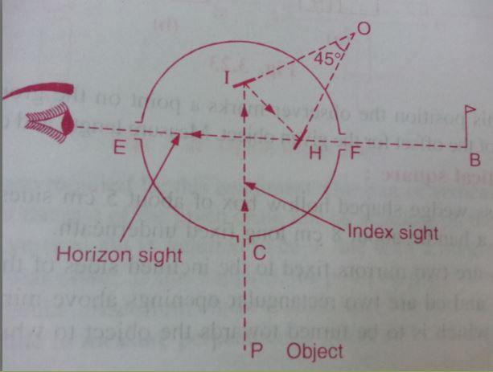
Q-7 Explain with sketch principle of optical square.
Ans.: Setting up the perpendicular by optical square
The observer should stand on the chin line and approximately at the position where the perpendicular is to be set up.
The optical square is held by the arm at the eye level. The ranging road at the forward section B is observed through the unsilvered portion on the lover part of the horizon glass.
Then the observer looks through the upper silvered portion of the horizon glass to see the image of the object of P.

Slide 14
Suppose that the observer find that the ranging rod B and the image of object p do not concede, than he should move forward or backward along the chain line until the ranging rod B and the image of P exactly concede.
At this position the observer marks a point on the ground to locate the foot of the offsets for the given object. Measure length and chain age of offsets.
 |  | P
 |  |  | B
 |  | P
 |  | B

Slide 15
Q-8 Explain Perpendicular and Oblique Offsets
Ans.: (1) Perpendicular Offsets
The offsets which are taken perpendicular to the chain line are termed as perpendicular offsets. These offsets are taken by holding zero end of the tape at the object and swinging the tape on the chain line. The shortest distance whatsoever measured form object to the chain line is always a perpendicular offsets.

Slide 16
(2)Oblique Offsets
Oblique distance is always grater the perpendicular distance. All the offsets which are not taken at right angle to chain line are known as oblique offsets.
The distance on the chain line at which the foot of the offset is taken is known as a ‘chainage’.
According length, the offsets having length greater than or equal to 15.0m are termed as ‘long offset’ and the offsets of length less than 15.0m are known as ‘short’ offsets. Short offsets are more accurate than long offsets.

Slide 17
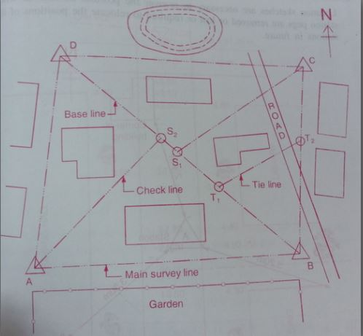
Q-9 Line of transverse
.

Slide 18
Definitions
Boundary line : The line joining the main station are called boundary lines or chain line.
Base Line
The line on which the framework of the survey is built is known as the ‘base line’. It is the most important line of the survey. Generally, the longest of the main line is considered as the base line. This line should be taken through fairly level ground and should be measured very carefully and accurately.
Tie line A line tie station is termed as a tie line. It is run to take the interior details which are far away from the main line and also to avoid long offsets. It can also serve as check line.
Check Line
The line joining the apex point of triangle to some fixed point on its base is known as the ‘check line’. It is to check the accuracy of the triangle. Sometimes this line helps to locate interior details

Slide 19
Taking Measurements on Papers

